Slide 1
5.1 Mutable & Immutable Datatypes
Python Objects & Datatypes
Recall
Python objects have
An identity
A type
A value
A datatype consists of a set of values and a set of operations.
An object’s address in memory
Determines the operations that may be performed on an object and the possible values an object may have
The actual value associated with an object
1
21/10/2022
Notes:
1

Slide 2
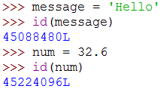
5.1 Mutable & Immutable Datatypes
Python Objects & Datatypes
We can check the identity of a Python object using the id() function
The identity of an object never changes once it has been assigned.
2
21/10/2022
Notes:
2

Slide 3
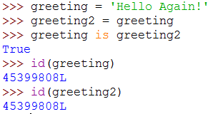
5.1 Mutable & Immutable Datatypes
Python Objects & Datatypes
We can check the to see if two objects have the same identity using the is operator
greeting
program identifiers
greeting2
Address | Value
...
45399808L | Hello Again!
...
memory
3
21/10/2022
Notes:
3

Slide 4
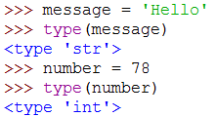
5.1 Mutable & Immutable Datatypes
Python Objects & Datatypes
We can check the type of a Python object using the type() function
The type of an object is generally unchangeable once it has been assigned.
4
21/10/2022
Notes:
4

Slide 5
5.1 Mutable & Immutable Datatypes
Python Objects & Datatypes
Datatypes can be classified as either mutable or immutable in Python.
Objects whose value can change are said to be mutable.
Objects whose value is unchangeable once they are created are said to be immutable.
5
21/10/2022
Notes:
5

Slide 6
5.1 Mutable & Immutable Datatypes
Python Objects & Datatypes
Mutable | Immutable
list | string
dict | tuple
bytearray | int
 | float
Strings are an immutable datatype in Python.
6
21/10/2022
Notes:
6

Slide 7
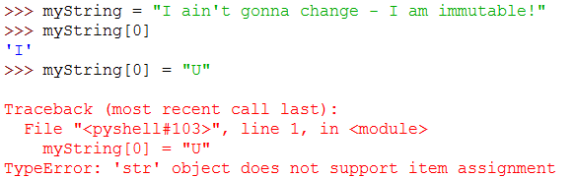
5.1 Mutable & Immutable Datatypes
Python Objects & Datatypes
Strings are an immutable datatype in Python.
What happens if we attempt a similar operation with a list datatype?
7
21/10/2022
Notes:
7

Slide 8
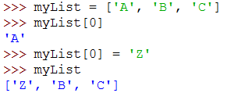
5.1 Mutable & Immutable Datatypes
Python Objects & Datatypes
What happens if we attempt a similar operation with a list datatype?
We can alter the list in place because the list datatype is mutable.
8
21/10/2022
Notes:
8

Slide 9
5.3 String Methods
Formatting Strings
Python provides a useful string formatting operator
To use the % opeartor with a string
Specify placeholders in the string that will contain formatted values
Use the % character with a formatting mask within the string that will contain formatted values
Supply a set of values for each of the placeholders using a tuple data structure via the % operator
Example
%
9
21/10/2022
Notes:
9

Slide 10
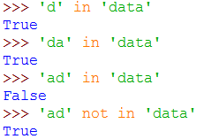
5.3 String Methods
in / not in
We can check to see if a certain string is in another string by using the in and not in operators
Example
10
21/10/2022
Notes:
10

Slide 11
5.3 String Methods
split
s.split() – turns a string into a list of tokens using a separator (by default " ")
s.split(sep,maxsplits) to limit the number of splits (and specify a particular separator)
List.join(string) undoes split
s.strip() removes whitespace
rstrip and rsplit do what you would expect
11
21/10/2022
Notes:
11

Slide 12
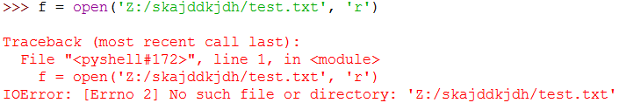
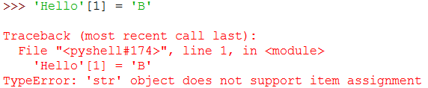
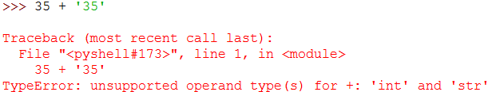
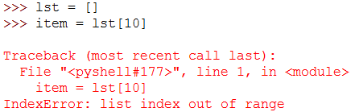
5.4 Exception Handling
Exception Handling
12
21/10/2022
Notes:
12

Slide 13
5.4 Exception Handling
Exception Handling
Python implements exception handling using try ... except blocks
We can specify code that will execute when an exception is raised
This is called handling the exception
If we know that some code may raise an exception we should handle the possible execption by using a try ... except block
When opening files
When connecting to databases etc
13
21/10/2022
Notes:
13

Slide 14
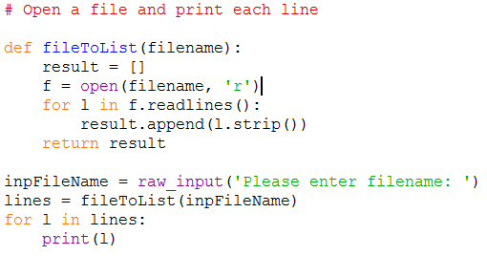
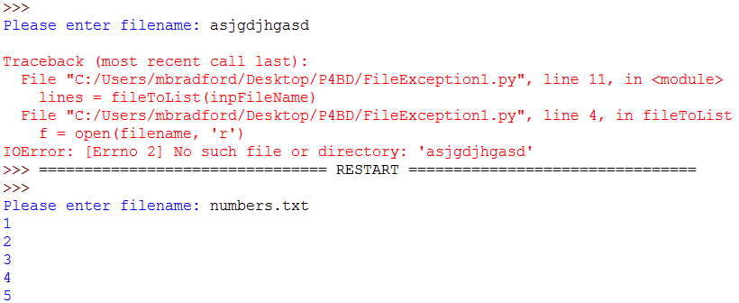
5.4 Exception Handling
Exception Handling
Example
14
21/10/2022
Notes:
14

Slide 15
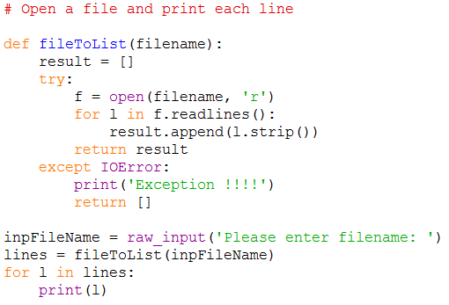

5.4 Exception Handling
Exception Handling
Example
15
21/10/2022
Notes:
15

Slide 16
5.5 Dictionaries
Dictionaries
Often we will want to maintain a data structure consisting of key-value pairs
Associative Array
Hash Table
Dictionary
Python provides a dictionary datatype
Key
'little'
'medium'
'large'
Value
1
2
3
16
21/10/2022
Notes:
16

Slide 17



5.5 Dictionaries
Dictionaries
We can create dictionary types in the following ways:
We can read back the values in the following ways:
17
21/10/2022
Notes:
17

Slide 18
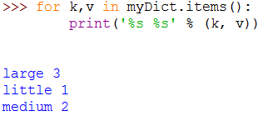
5.5 Dictionaries
Dictionaries
We can check if a dictionary has a certain key in the following way:
key in myDict
We can iterate over the collection in the following way:
18
21/10/2022
Notes:
18

Slide 19


5.5 Dictionaries
Dictionaries
To get all the keys in the dictionary:
To update a key value:
19
21/10/2022
Notes:
19

Slide 20

5.5 Dictionaries
Dictionaries
To add a new key value pair to the dictionary:
20
21/10/2022
Notes:
20

